Slide 1
Twitter Analyzer
Presented By: Natnael Birhanu Ajema
Big Data Technology
Prof. Mrudula Mukadam

Slide 2
Agenda
Introduction
Primary goals
Technology stack
Environment Set Up
Data Processing flow
Java Application

Slide 3
Introduction
Twitter analyzer is a sample application that analyzes tweets for various topics using a big data technology stack. The program uses the Twitter API to stream distinct tweets by keyword and displays public metrics such as retweet count, like count, reply count, and quote count. Twitter API, Kafka, Spark Stream, Spark SQL, and HBase are all used in the application.

Slide 4
Primary goals
The project's main purpose is to interact with real-time data using the spark framework.

Slide 5






Technology Stack
Cloudera VM
Kafka
Spark
HBase
Hive
Twitter API
Java

Slide 6
Why Spark instead of Hadoop?
Processing: Data processing takes place in a distributed environment on both platforms. While Hadoop is best suited for batch processing and linear data processing, Spark is best suited for real-time processing and processing live unstructured data streams.
Performance: On both systems, data is processed in a distributed environment. While Hadoop excels in batch processing and linear data processing, Spark excels at real-time processing and live unstructured data streams.
Cost: Hadoop is less expensive to run since it uses any disk storage type for data processing. Spark, on the other hand, has a greater cost since it requires in-memory calculations that require large amounts of RAM to spin up nodes for real-time data processing.

Slide 7
Apache Kafka
Distributed
Highly Scalable
Fault -tolerance
Secure manner
Apache Kafka is part of a general family of technologies known as queuing, messaging, or streaming engines.
Apache Kafka is a community distributed event streaming platform capable of handling trillions of events a day

Slide 8
Apache Kafka Capabilities
Publish
Write Data
Subscribe
Read streams of data
Store
Streams of evens as they occur or retrospectively
Process
Streams of events durably
1
2
3
4

Slide 9
Environment set up
Installation of the Apache Kafka
Download Apache Kafka from https://kafka.apache.org/downloads
Choose the version of Apache Kafka
Create a folder which will hold the Apache Kafka sources
mkdir kafka
cd kafka
Extract the archive in the created folder
tar -xvzf /home/cloudera/Downloads/kafka_2.12-3.0.0.tgz --strip 1
Update the profile file and create the environment variables
cd ~
sudo gedit $HOME/.bash_profile
export KAFKA_HOME=/home/cloudera/kafka/
PATH=$PATH:$HOME/bin:$JAVA_HOME/bin:$KAFKA_HOME/bin
~/.bash_profile
Test Kafka
kafka-topics.sh

Slide 10
Environment set up
Creating Producer and consumer
Verify zookeeper is it up and running
service --status-all
Start the Apache Kafka Server
$KAFKA_HOME/bin/kafka-server-start.sh $KAFKA_HOME/config/server.properties
Open new Terminal & Create new topic
$KAFKA_HOME/bin/kafka-topics.sh --create --bootstrap-server localhost:9092 --replication-factor 1 --partitions 1 --topic TwitterKafak
Display list of topics
$KAFKA_HOME/bin/kafka-topics.sh --list --bootstrap-server localhost:9092
Create producer who will Publish some messages
$KAFKA_HOME/bin/kafka-console-producer.sh --broker-list localhost:9092 --topic fruits
Open new Terminal & Start Consuming the above messages
$KAFKA_HOME/bin/kafka-console-consumer.sh --bootstrap-server localhost:9092 --topic TwitterKafka --from-beginning

Slide 11
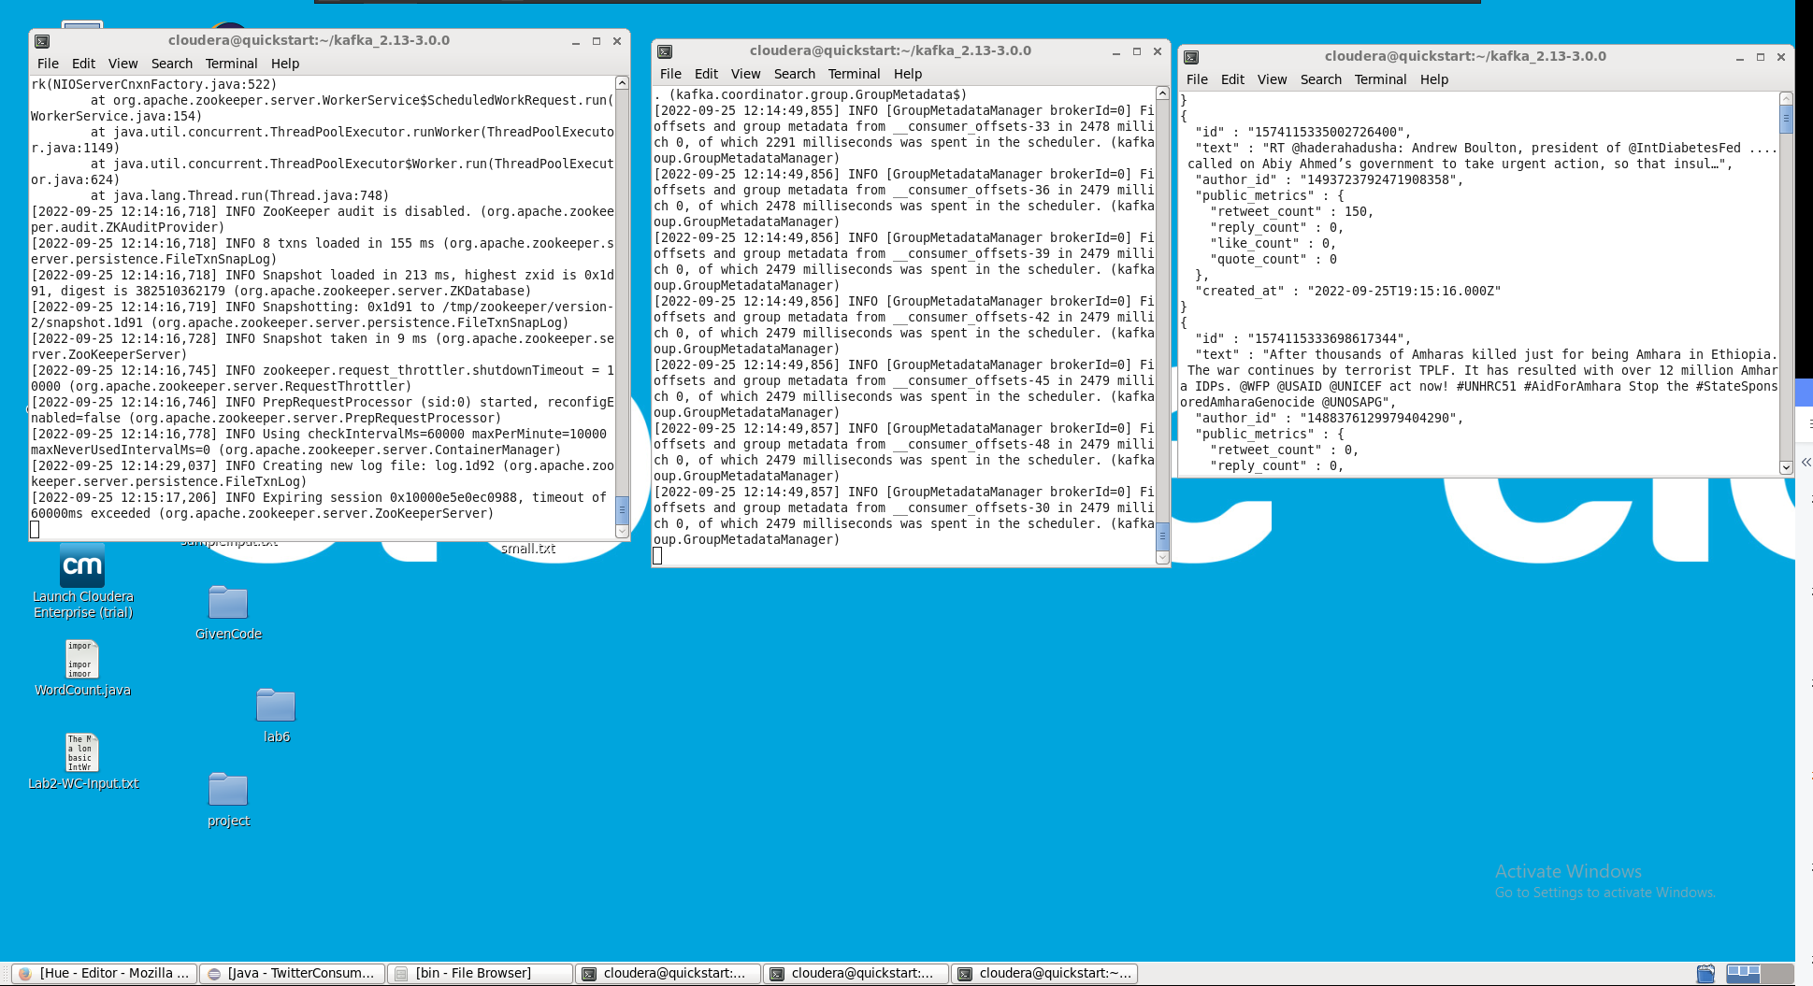
Twitter Kafka Consumer

Slide 12

Data Flow
Twitter
API
Kafka
Producer
TwitterKafka topic
Kafka
Consumer
Spark
Streaming
HBase
Table
Spark SQL
Hive
Query

Slide 13
Twitter Analyzer System
Twitter Producer
Twitter Consumer App
Twitter Spark SQL App
Java application
Consume data from Twitter API using keywords every 3 seconds
Publish the twittes to kafka using TwitterKafka topic
Java application
Consume Realtime twittes using Kafka consumer
Use Java Spark stream framework to process data
HBase used to store the data from spark stream
Java application
Data query from Hbase
Spark SQL is frame work is used to query data

Slide 14
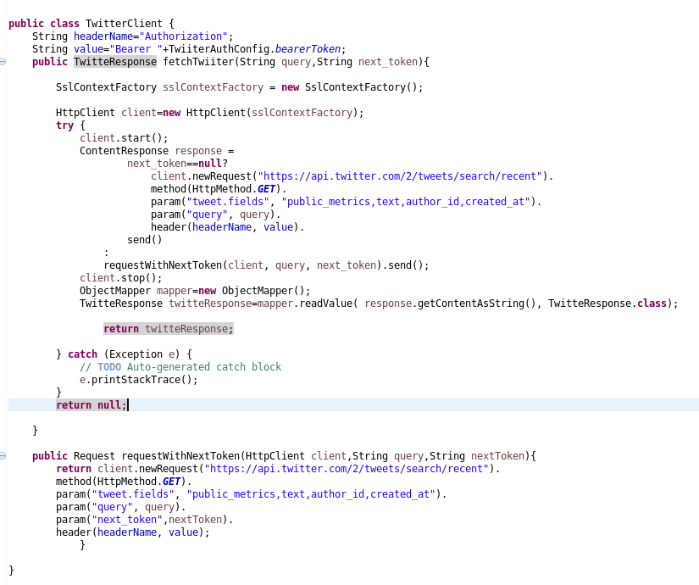
Twitter Producer App
Twitter API
Free Twitter API is used to get Data for our application
TwitterClient class is used to retrieve the data
fetchTwitter is method called every 3 seconds to get data with keyword/query and next token
The rest API call is achived by Eclipse Jetty library

Slide 15
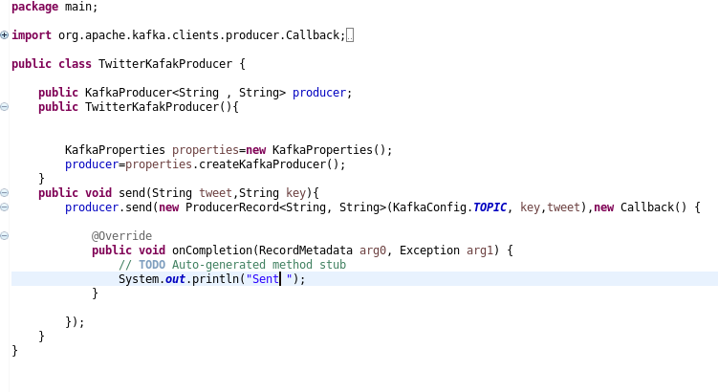
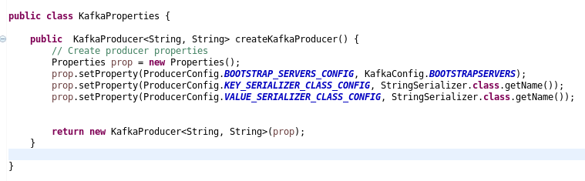
Twitter Producer App
Kafka Producer
TwitterKafka class is obligate to create the instance of Kafka consumer with properties and send data to twitter
The class is created form TwitterProducerApp class
send is method called every 3 seconds to from main application to send data with keyword/query and key
The kafka consumer instance will be closed every 3 seconds after data being sent

Slide 16
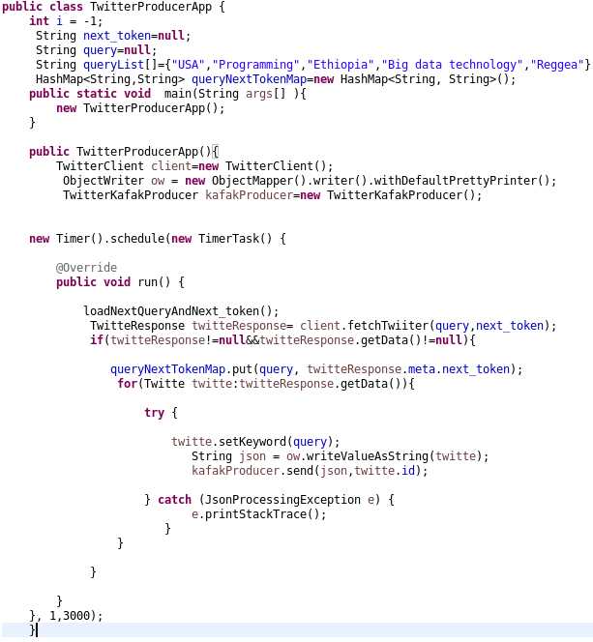
Twitter Producer App
Twitter client and Kafka Producer integration
TwitterProducer class integrates twitter client and kafka producer
Java Timer will be used to schedule task , retrieve tweets and send data
The query and next token will be loaded from map before every call to twitter

Slide 17
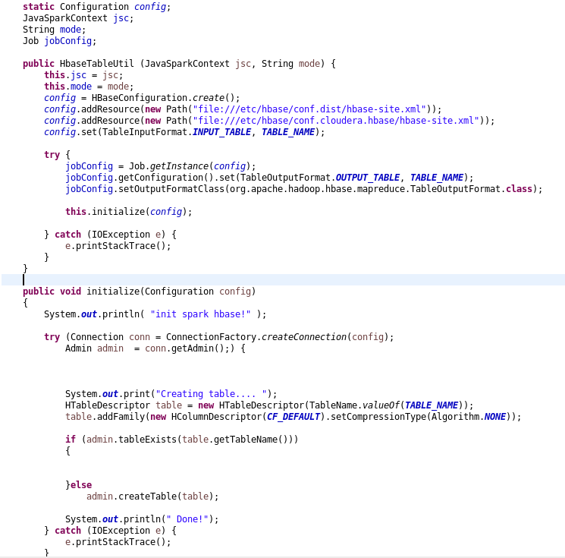
Twitter Consumer App
HBase Configuration
HBase util class is used to create connection with configuration
Job instance will get by the config to initialize the connection and table description
Twitter and tweet are table name and Column default accordingly
writeRowNewHadoopAPI is method called from SparkStream instance to define twitter data column and save to the Hbase

Slide 18
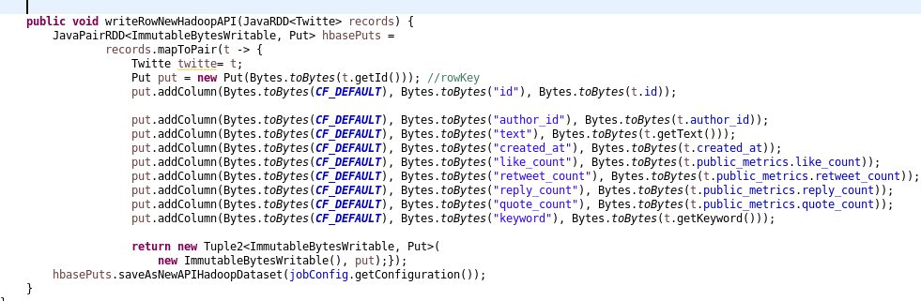
Twitter Consumer App
HBase Configuration

Slide 19
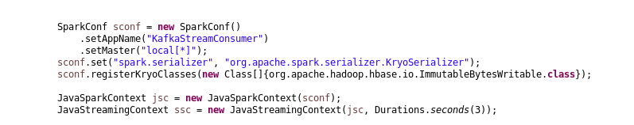
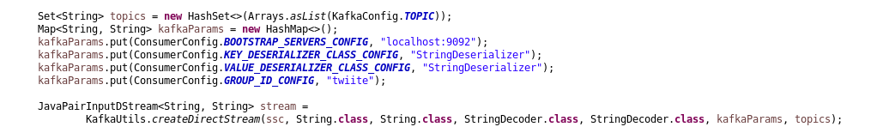
Twitter Consumer App
Integration
Twitter Consumer App class is used to integrate Kafka consumer , Spark stream and HBase
Steps configuring Spark stream
Set App name and master
Set serializer
Create java spark context using configuration
Create java streaming context using spark context, and 3 second batch interval;
Creating Kafka consumer client is second step in integration

Slide 20
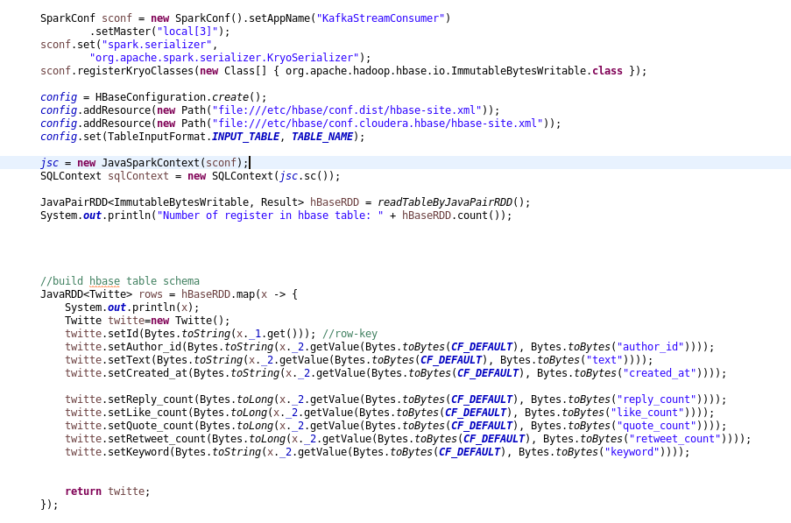
Twitter Consumer App
Spark SQL
Used to query data from HBase
Have a configuration to connect to HBase
JavaRDD will be used to map rows from java pairs of HBase data
It will have same Table and column family name
Has Data Frame to get Table data using spark context

Slide 21
Hive
CREATE EXTERNAL TABLE IF NOT EXISTS twitter (
id STRING, text STRING, author_id STRING, keyword STRING, retweet_count INT ,
reply_count INT, like_count INT, quote_count INT
)
STORED BY 'org.apache.hadoop.hive.hbase.HBaseStorageHandler'
WITH SERDEPROPERTIES (
'hbase.columns.mapping'=':key, tweet:text,tweet:keyword, tweet:author_id,tweet:retweet_count,
tweet:reply_count, tweet:like_count, tweet:quote_count'
)
TBLPROPERTIES ('hbase.table.name' = 'twitter');
Query a data using by creating external database

Slide 22
Thank you

